Slide 1




QA Fundamentals – Course Introduction
Scope, Objective, Target Audience, Schedule
QA
Fundamentals
Ivan Yonkov
Technical Trainer
https://github.com/RoYaLBG
Software University
http://softuni.bg

Slide 2

Table of Contents
Course scope
Course objective
Exercises and labs
Examination
Learning resources

Slide 3

Course Scope and Objectives

Slide 4
QA Fundamentals – Course Objectives
Knowledge of the software development process
Knowledge of the QA part
Skills in automation testing, border cases
Ability to start work as a QA engineer

Slide 5
QA Fundamentals – Course Scope
Course introduction
Introduction to software development and software testing
Bug tracking systems and reporting issues
Making test cases, scenarios and execution

Slide 6
QA Fundamentals – Course Scope (2)
Reading, examining and writing an SRS
Test automation and selenium
Software development and testing lifecycles
Testing types
Practical exam

Slide 7
Exercises and Labs

Slide 8
Exercises and Labs
Special lessons which points how to solve a problem
Labs are two types
Exercises in the middle of the lecture
Four hours exercises as part of the main program

Slide 9

QA Fundamentals: More Details
Duration, Languages, Technologies

Slide 10

Training Duration – QA Fundamentals
Lectures: ~ 20 hours (onsite + YouTube videos)
Practical exercises (in class): ~ 20 hours
Homework: ~ 30-40 hours
Teamwork project: ~ 10-20 hours
Schedule: July – August 2015
Practical exam: 29 August 2015

Slide 11



Why English?
Why the slides are in English?
English is the native language of the software engineers
Specific terminology should be in English
Translations are inaccurate and funny
Just learn English!
No excuses

Slide 12
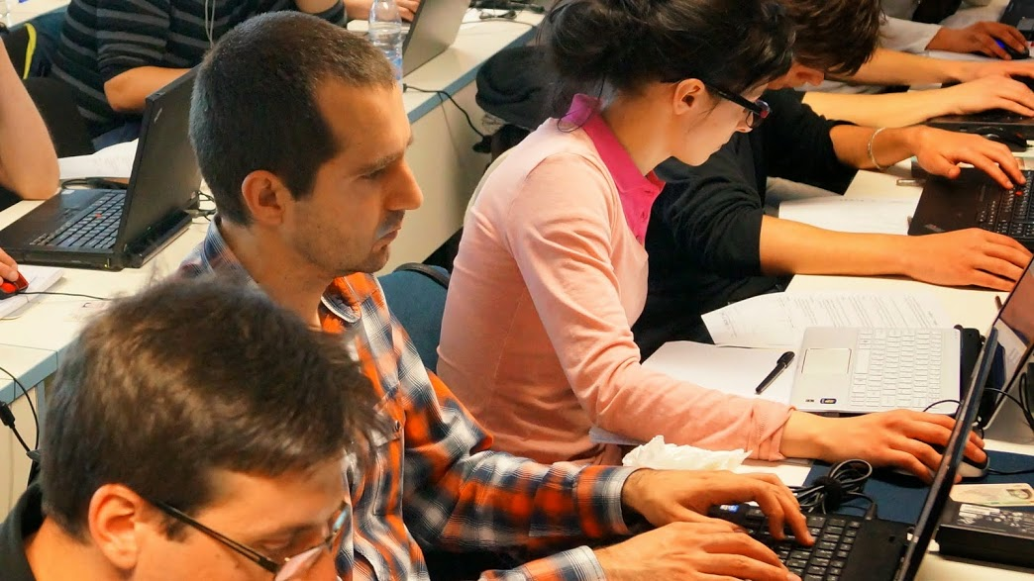


QA Fundamentals
Evaluation Criteria

Slide 13


Scoring System for the “QA Fundamentals"
Practical exam – 80%
Team project – 20%
Bonuses: Homework + evaluation – 10%

Slide 14

QA Fundamentals – Team Project
Each team will consist of 6 students
Teams will be created one week after the first lecture
Duration – about 1 month
Team project defense – on 23 August

Slide 15
QA Fundamentals – Team Project (2)
The team should create a software project either with
Code
SRS
Diagrams
On the above project/specification – make test scenarios
Automate some of the work (optional)
Use Issue tracking system

Slide 16
QA Fundamentals – Practical Exam
The practical exam tests your skills on:
Planning tests
Finding bugs
Automation
Reporting issues
Working with a bug tracking system

Slide 17
QA Fundamentals – Practical Exam (2)
Upon given project
Write scenarios
Manually test some of the functionality
Test automation upon given functionalities
Set deployment configuration
Set Bug tracking system workflow
Document all the work (bug reporting, fixing, etc…) in the BTS

Slide 18









QA Fundamentals
http://softuni.org/courses

Slide 19
License
This course (slides, examples, demos, videos, homework, etc.) is licensed under the "Creative Commons Attribution-NonCommercial-ShareAlike 4.0 International" license
Attribution: this work may contain portions from
"Fundamentals of Computer Programming with C#" book by Svetlin Nakov & Co. under CC-BY-SA license
"C# Part I" course by Telerik Academy under CC-BY-NC-SA license

Slide 20





Free Trainings @ Software University
Software University Foundation – softuni.org
Software University – High-Quality Education, Profession and Job for Software Developers
softuni.bg
Software University @ Facebook
facebook.com/SoftwareUniversity
Software University @ YouTube
youtube.com/SoftwareUniversity
Software University Forums – forum.softuni.bg

